Slide 1



Capstone Project

Slide 2
Presentation content
Problem statement
Brief about the project
Wireframe
Demo of the project
Technologies used
What was the most difficult part of the project
What was your favorite part of the project
What are the new things you learned creating this application

Slide 3
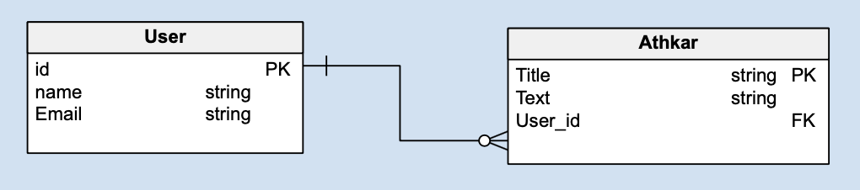
Entity Relationship Diagram

Slide 4

Brief about the project
The project is divided into tow Parts
Parts of the projects
Creat
Read
Update
Delete
The user can’t used it without Account
Athkar
Quran
Qibla
Setting
The user can use it without Account

Slide 5
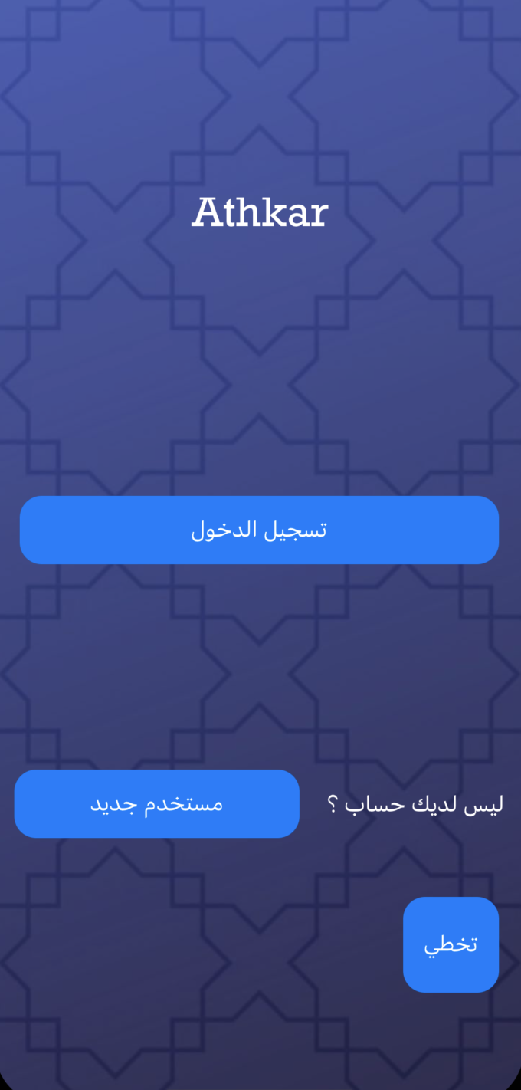
Part One
The user can create an account to use the CRUD feature or click on skip to go to the second part of the project and he does not have to create an account

Slide 6
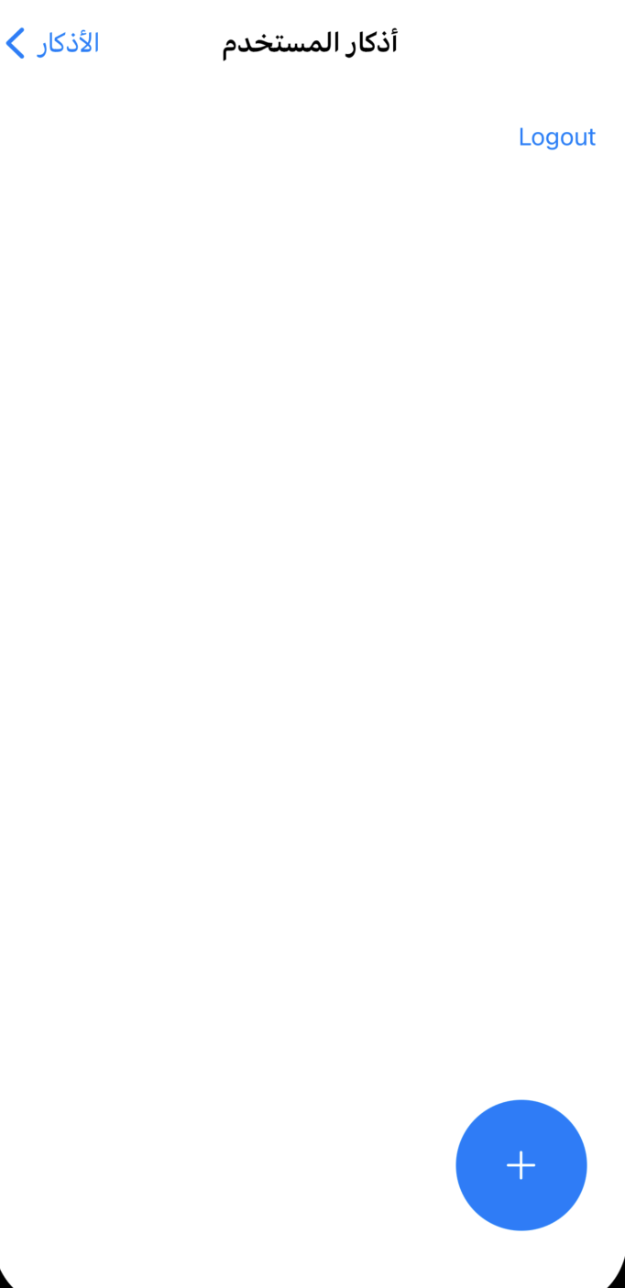
Part One
When creating an account, this interface can work CRUD

Slide 7
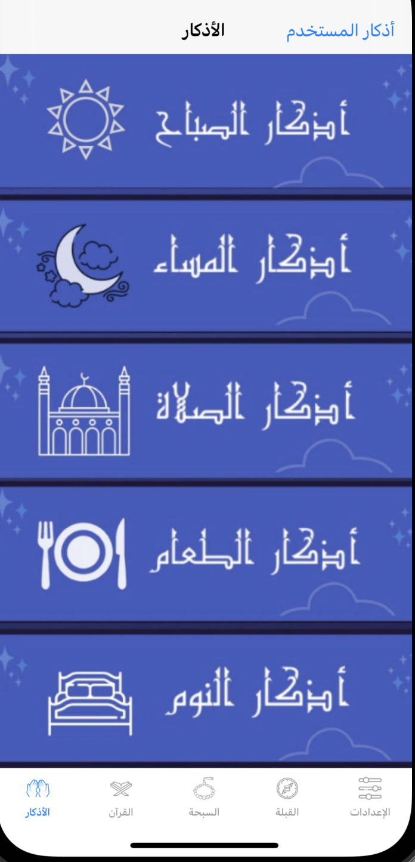
Part two
In this interface, the user can read the Athkar that are read in the day and night

Slide 8
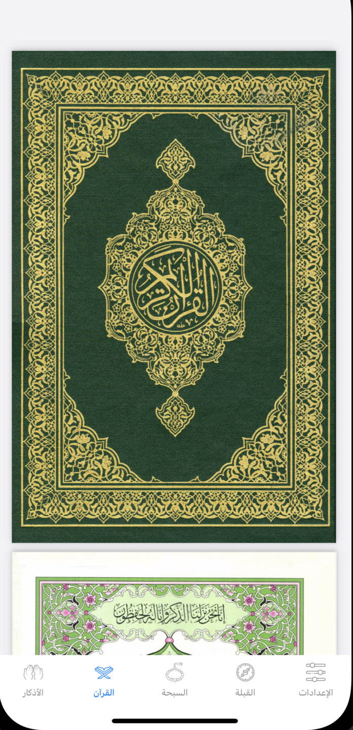
Part two

Slide 9
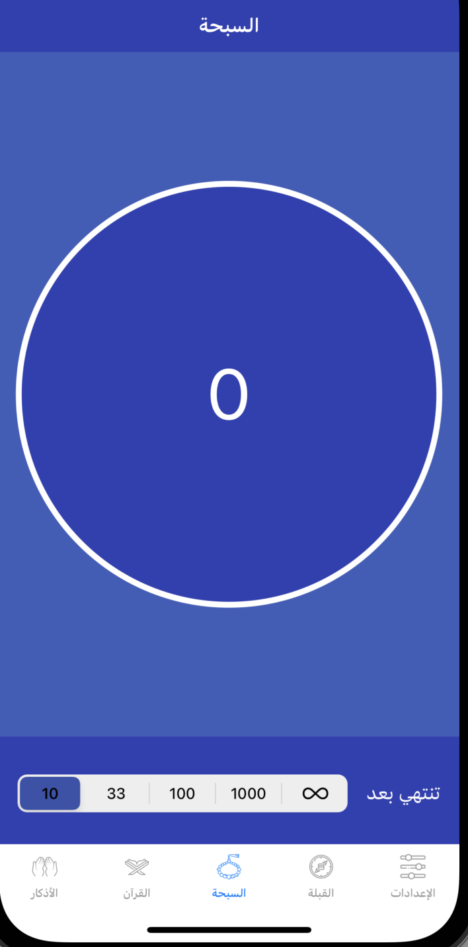
Part two

Slide 10
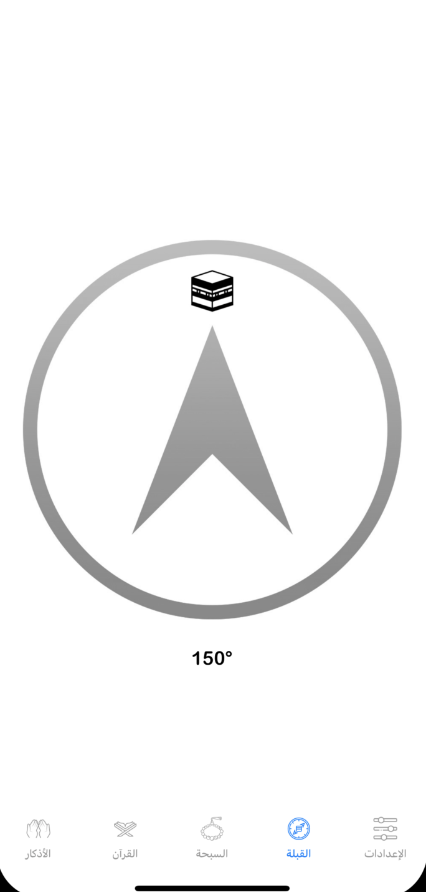
Part two

Slide 11
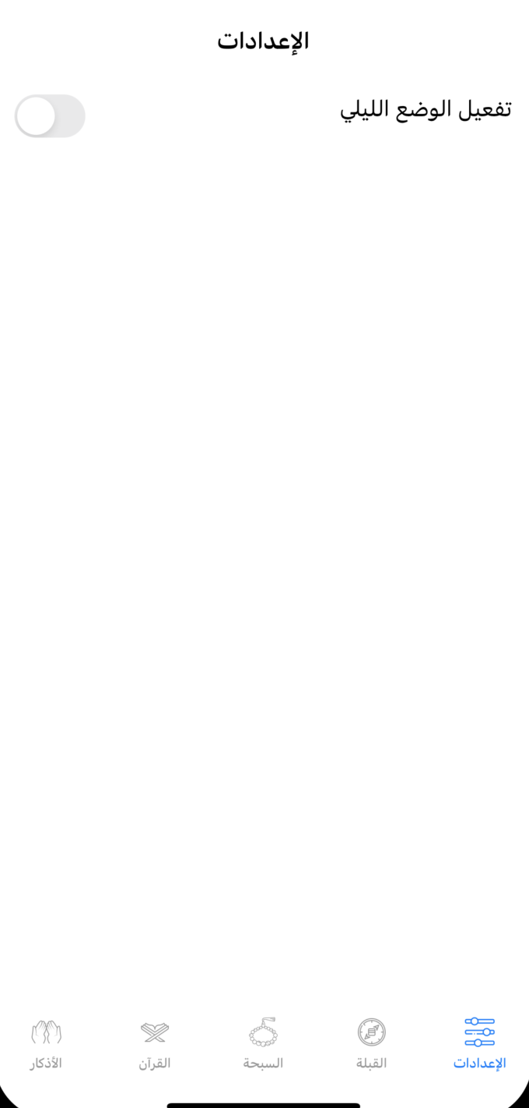
Part two

Slide 12
Demo of the project

Slide 13



Technologies used
HGCircularSlider
SDWebImage

Slide 14
What was the most difficult part of the project
Add to Firebase FireStore
Update to Firebase FireStore
Collection View Page

Slide 15
What was your favorite part of the project
Creat Section sebha and Using HGCircularSlider Library
Collection Page

Slide 16
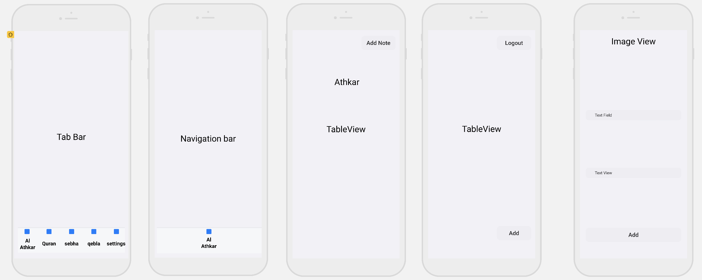
Wireframe

Slide 17
What are the new things you learned creating this application
I learned to use the Firebase
I learned to use libraries
I learned to use layer
I learned to use using PDF in Xcode

Slide 18
THANK YOU

